Slide 1
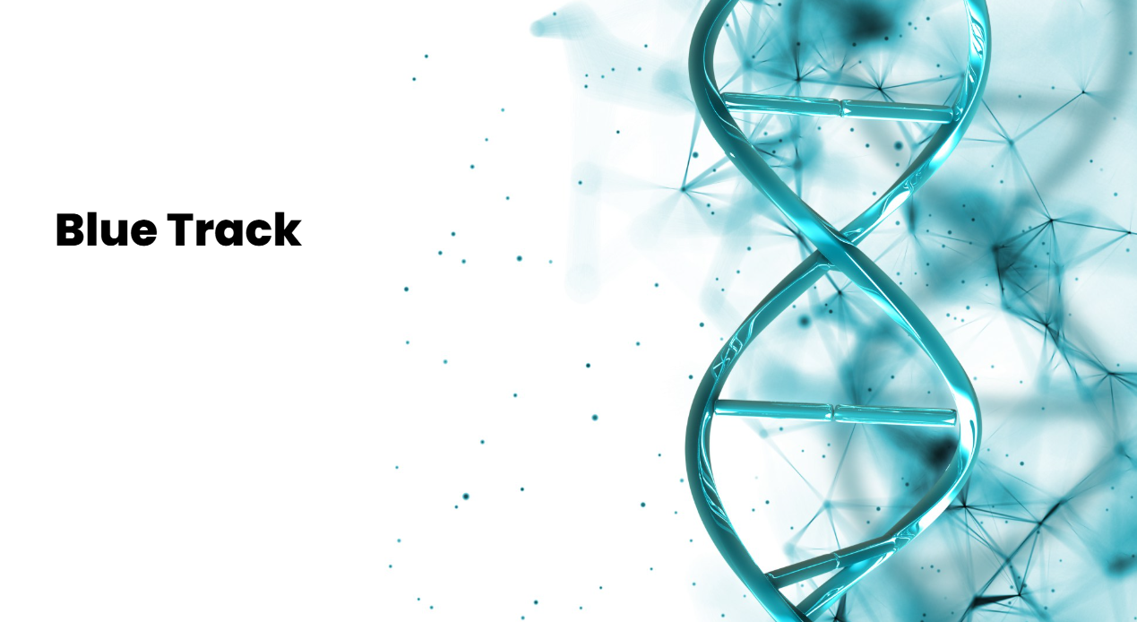
Advanced Predictive Marine Intelligence
We protect ocean life using artificial intelligence and satellite data

Slide 2

01. The Problem Threatened marine ecosystems and the lack of integrated information for their protection
02. The Solution Blue Track: an artificial intelligence platform for predicting marine behavior
Contents
03. How We Solve It Integration of satellite data, AI, and scientific visualization for marine conservation
04. Development Digital and physical prototypes using advanced technology for scientific validation

Slide 3
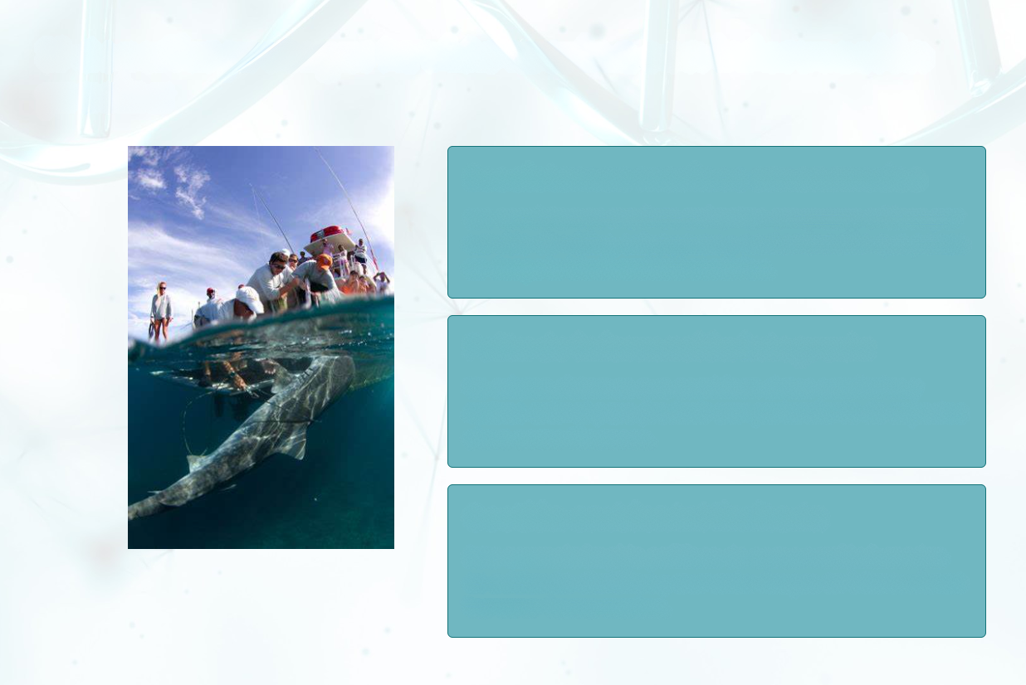
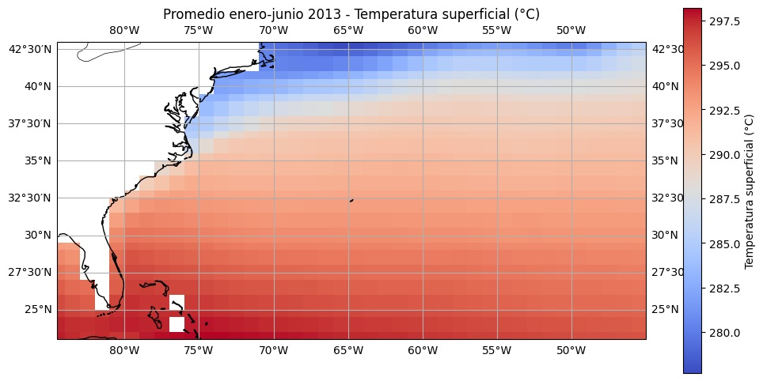
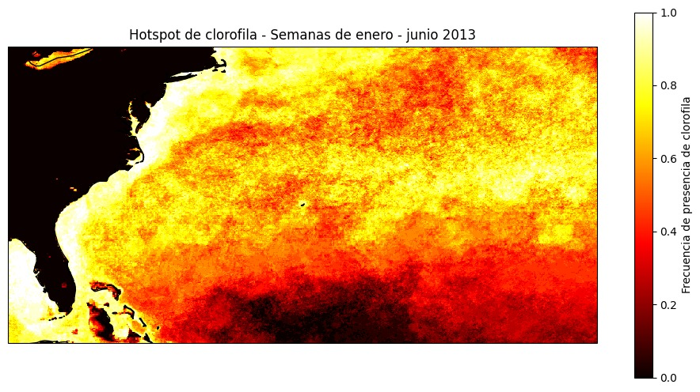
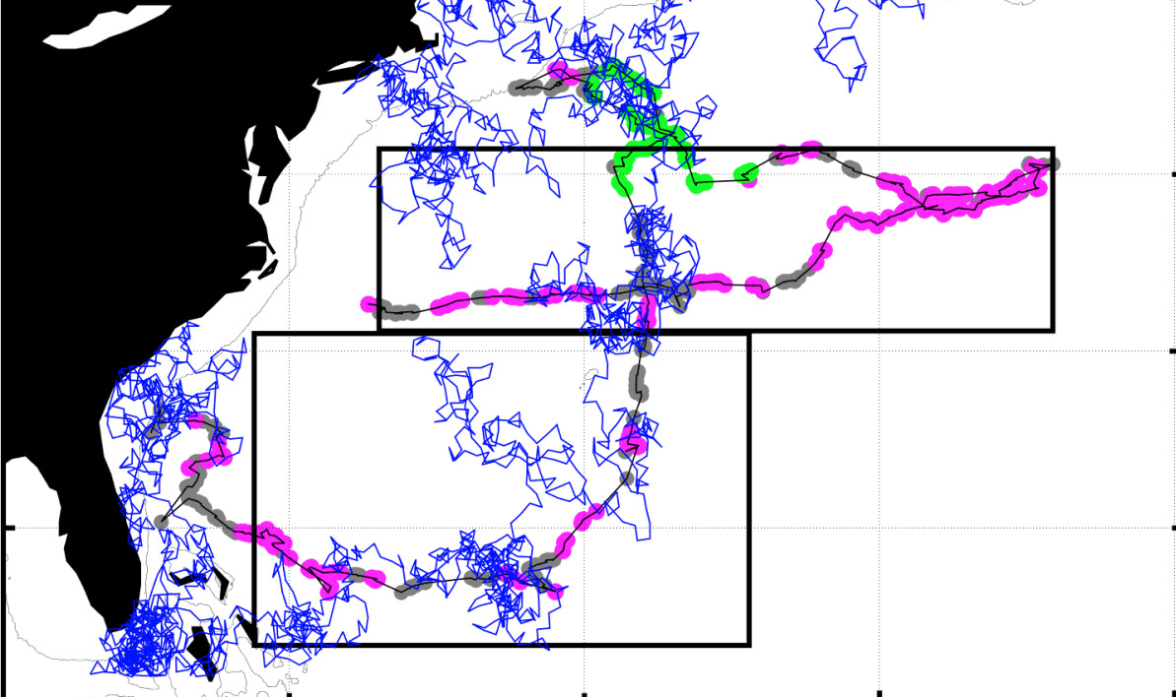
The Challenge Protecting Marine Life with Accurate Information
Threatened Marine Ecosystems
Marine ecosystems face critical threats from climate change, overfishing, and pollution, putting ocean biodiversity at risk.
Lack of Integrated Information
There are no systems that combine satellite data and animal tracking to predict the behavior of key species, such as sharks.
Limited Environmental Management
This gap prevents conservation policies based on scientific evidence and increases risks in human–marine wildlife interactions.

Slide 4
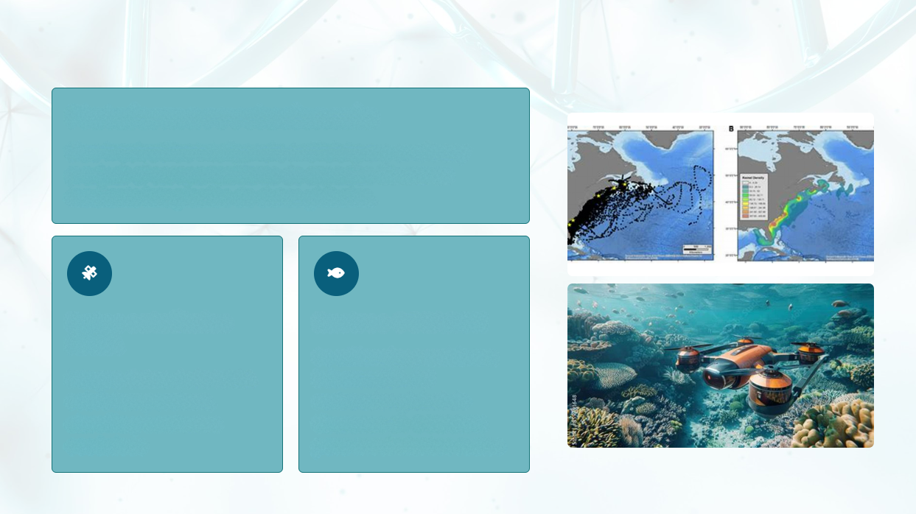
Blue Track Predictive Marine Intelligence
Revolutionary Platform Blue Track uses Artificial Intelligence to analyze and predict shark behavior by integrating global data.
NASA Satellite Data Incorporates NASA data on temperature, chlorophyll, and ocean currents.
OCEARCH Tracking Uses and combines information from OCEARCH’s global shark tracker to monitor real movements.

Slide 5
Data Fusion, Artificial Intelligence, and Applied Science
Data Collection
AI Processing
Prediction and Alerts
Visualization with Blue Track Cloud

Slide 6
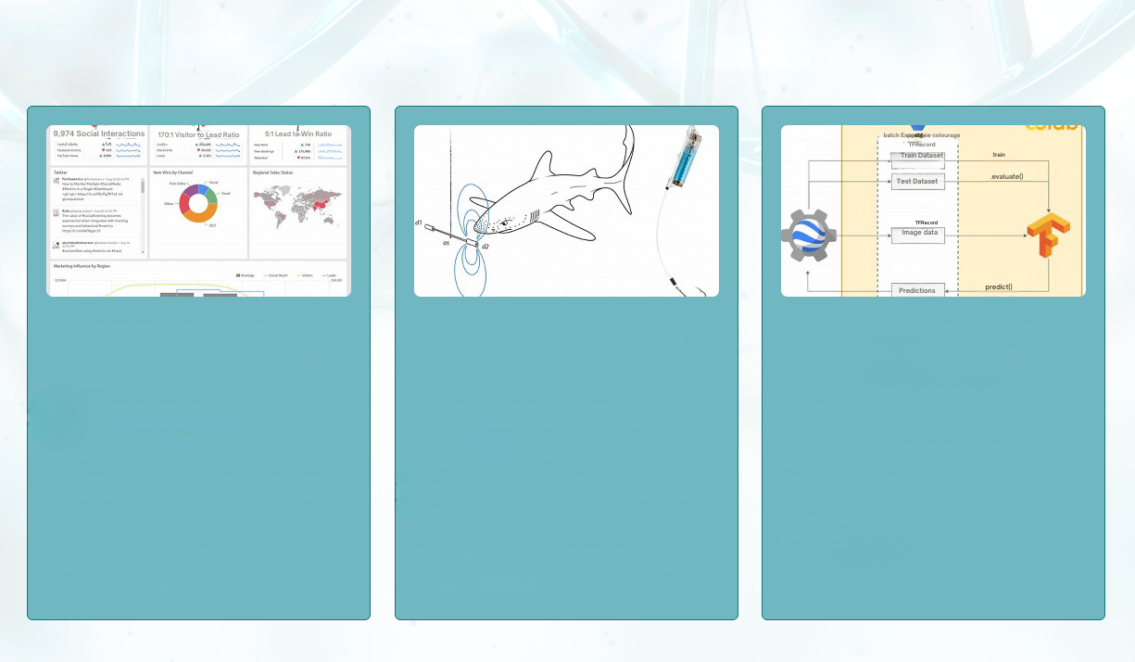
Blue Track Cloud and the SharkSense Sensor
Digital Prototype Blue Track Cloud
Integration of satellite and tracking data
Interactive real-time visualizations
Automatic predictions and alerts
Physical Prototype – SharkSense
Marine sensor with GPS and temperature tracking
Direct recording of shark habitat
Under development for prediction validation
Technology and Validation
Python
Integrated PostGIS and OCEARCH API
Pilot testing with NGOs and universities

Slide 7

Thank you for your attention
Any questions about Blue Track and smart marine conservation?

